Slide 1
Student's name: Dedan Lumumba
Institution affiliation: Sevennet Boot Camp
Course Name: Data Analytics
Instructor's Name: Mr. Raghuvendra Anshu
Date:18/07/2024
FINAL EXCEL PROJECT-MOVIE DATASET

Slide 2
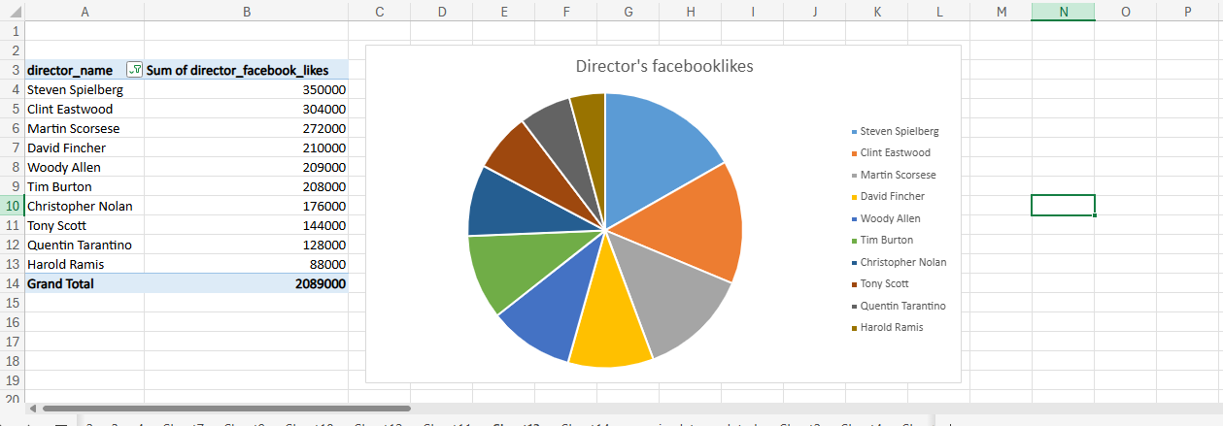
The information is useful in marketing a movie as it shows the director who is able to make sales of a movie on social media and where they can improve.

Slide 3
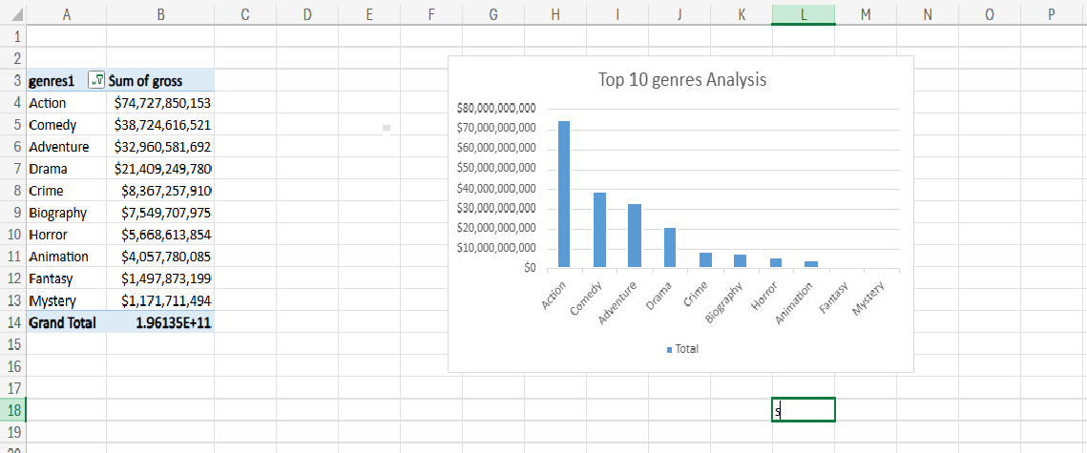
Analyzing which genre tend to perform well financially

Slide 4
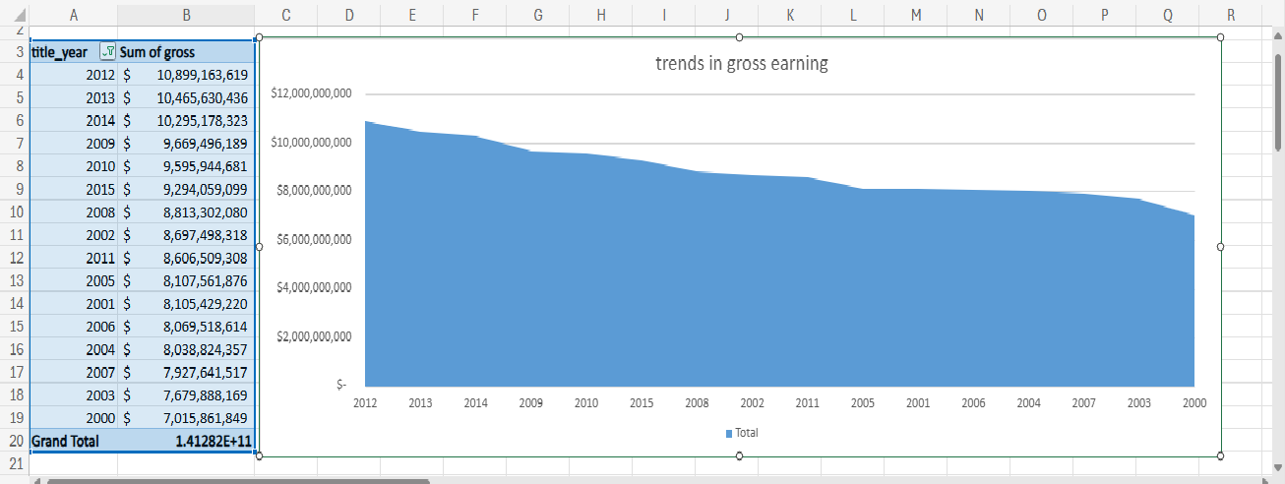
Identifying any significant changes in gross earnings over the years

Slide 5
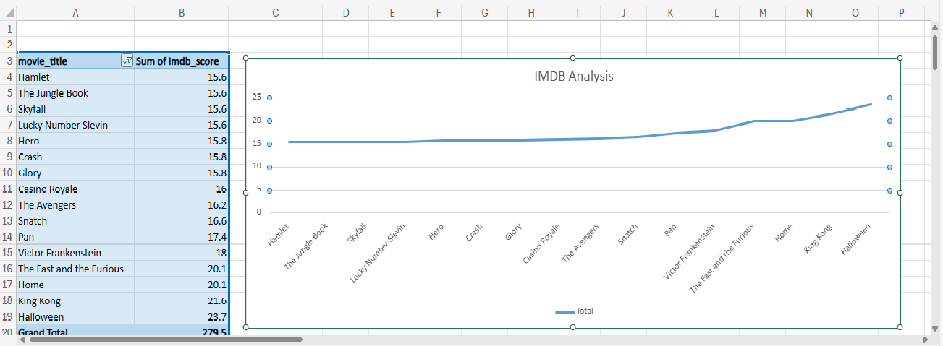
Analyzing movies by comparing their IMDB scores

Slide 6
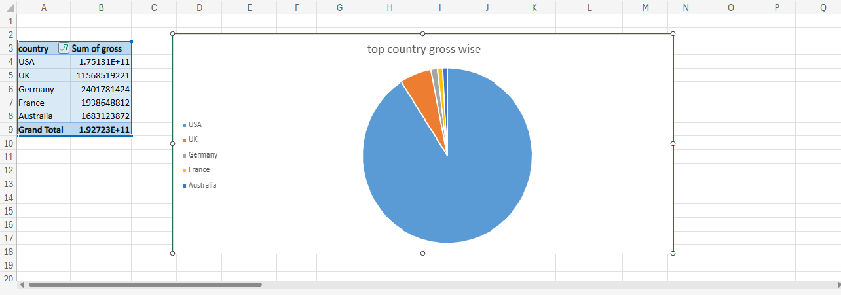
Analyzing top 5 countries with higher gross earnings

Slide 7
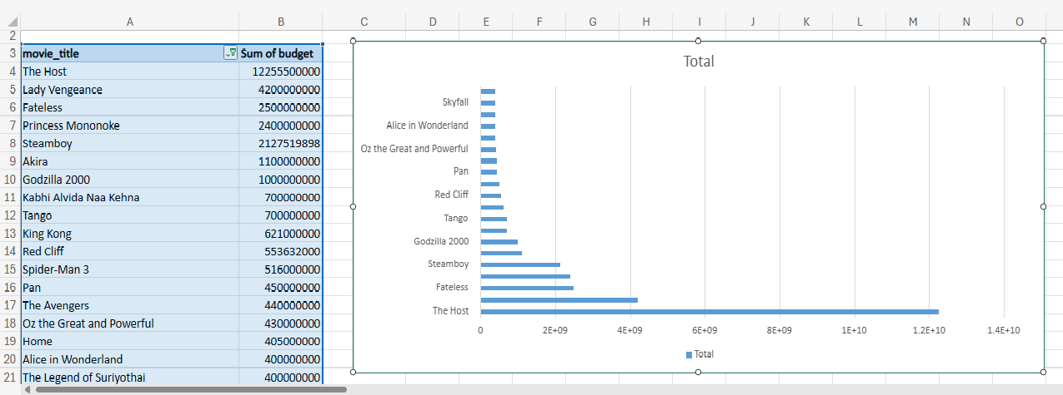
Comparing budgets made on various movies

Slide 8
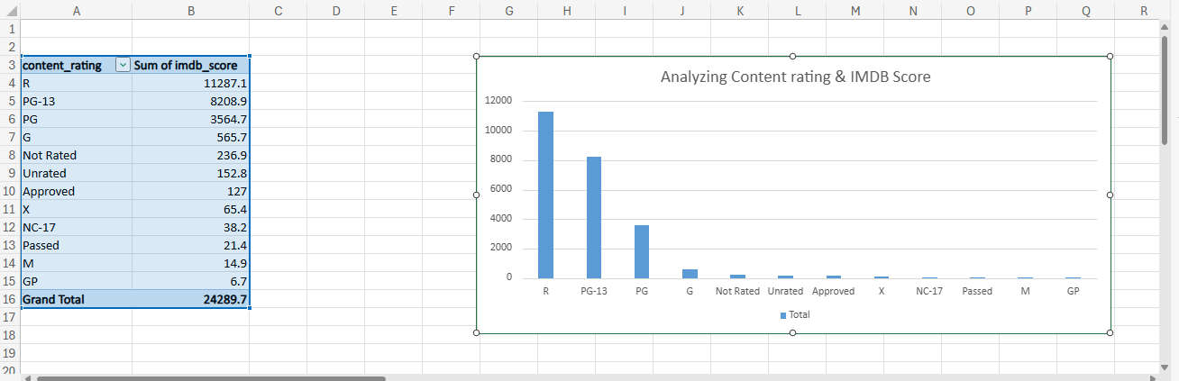
These ratings help guide viewers in selecting appropriate content based on their age and sensitivity to different types of material.

Slide 9
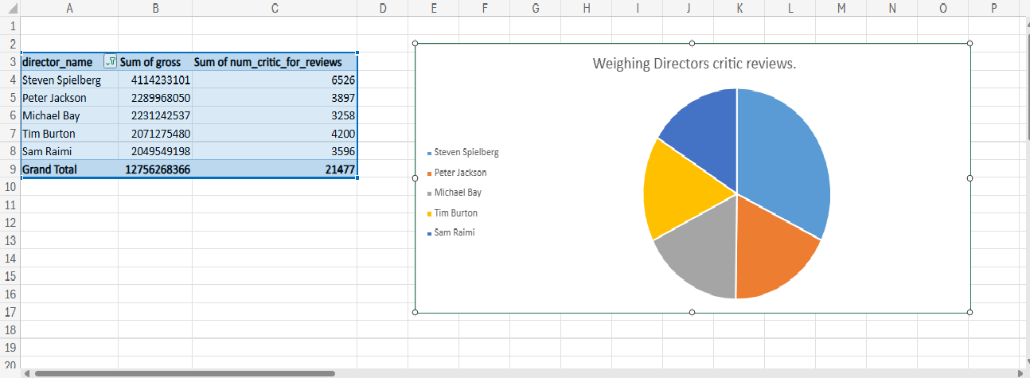
Analyzing the highest sum of critic reviews to find out the directors that produces the quality movies.

Slide 10
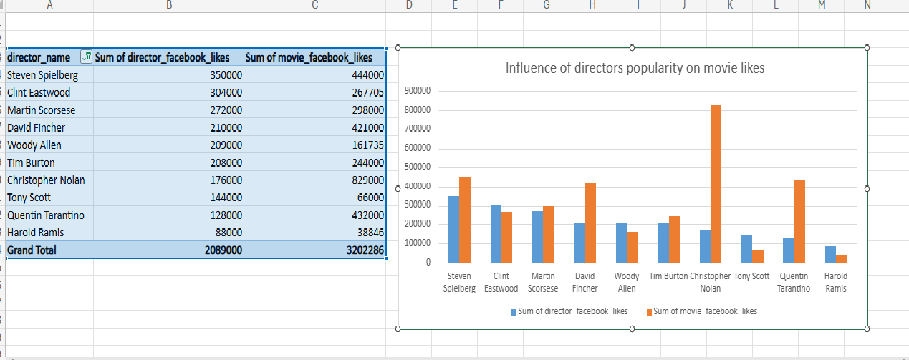
Helps to determine if the director's popularity on social media influences the popularity of their movies.

Slide 11
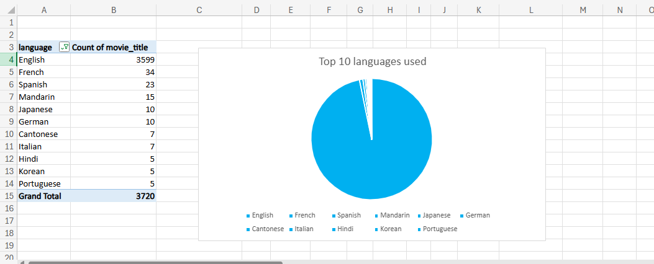
Helps in determining the language that will be watched across the board.

